Slide 1
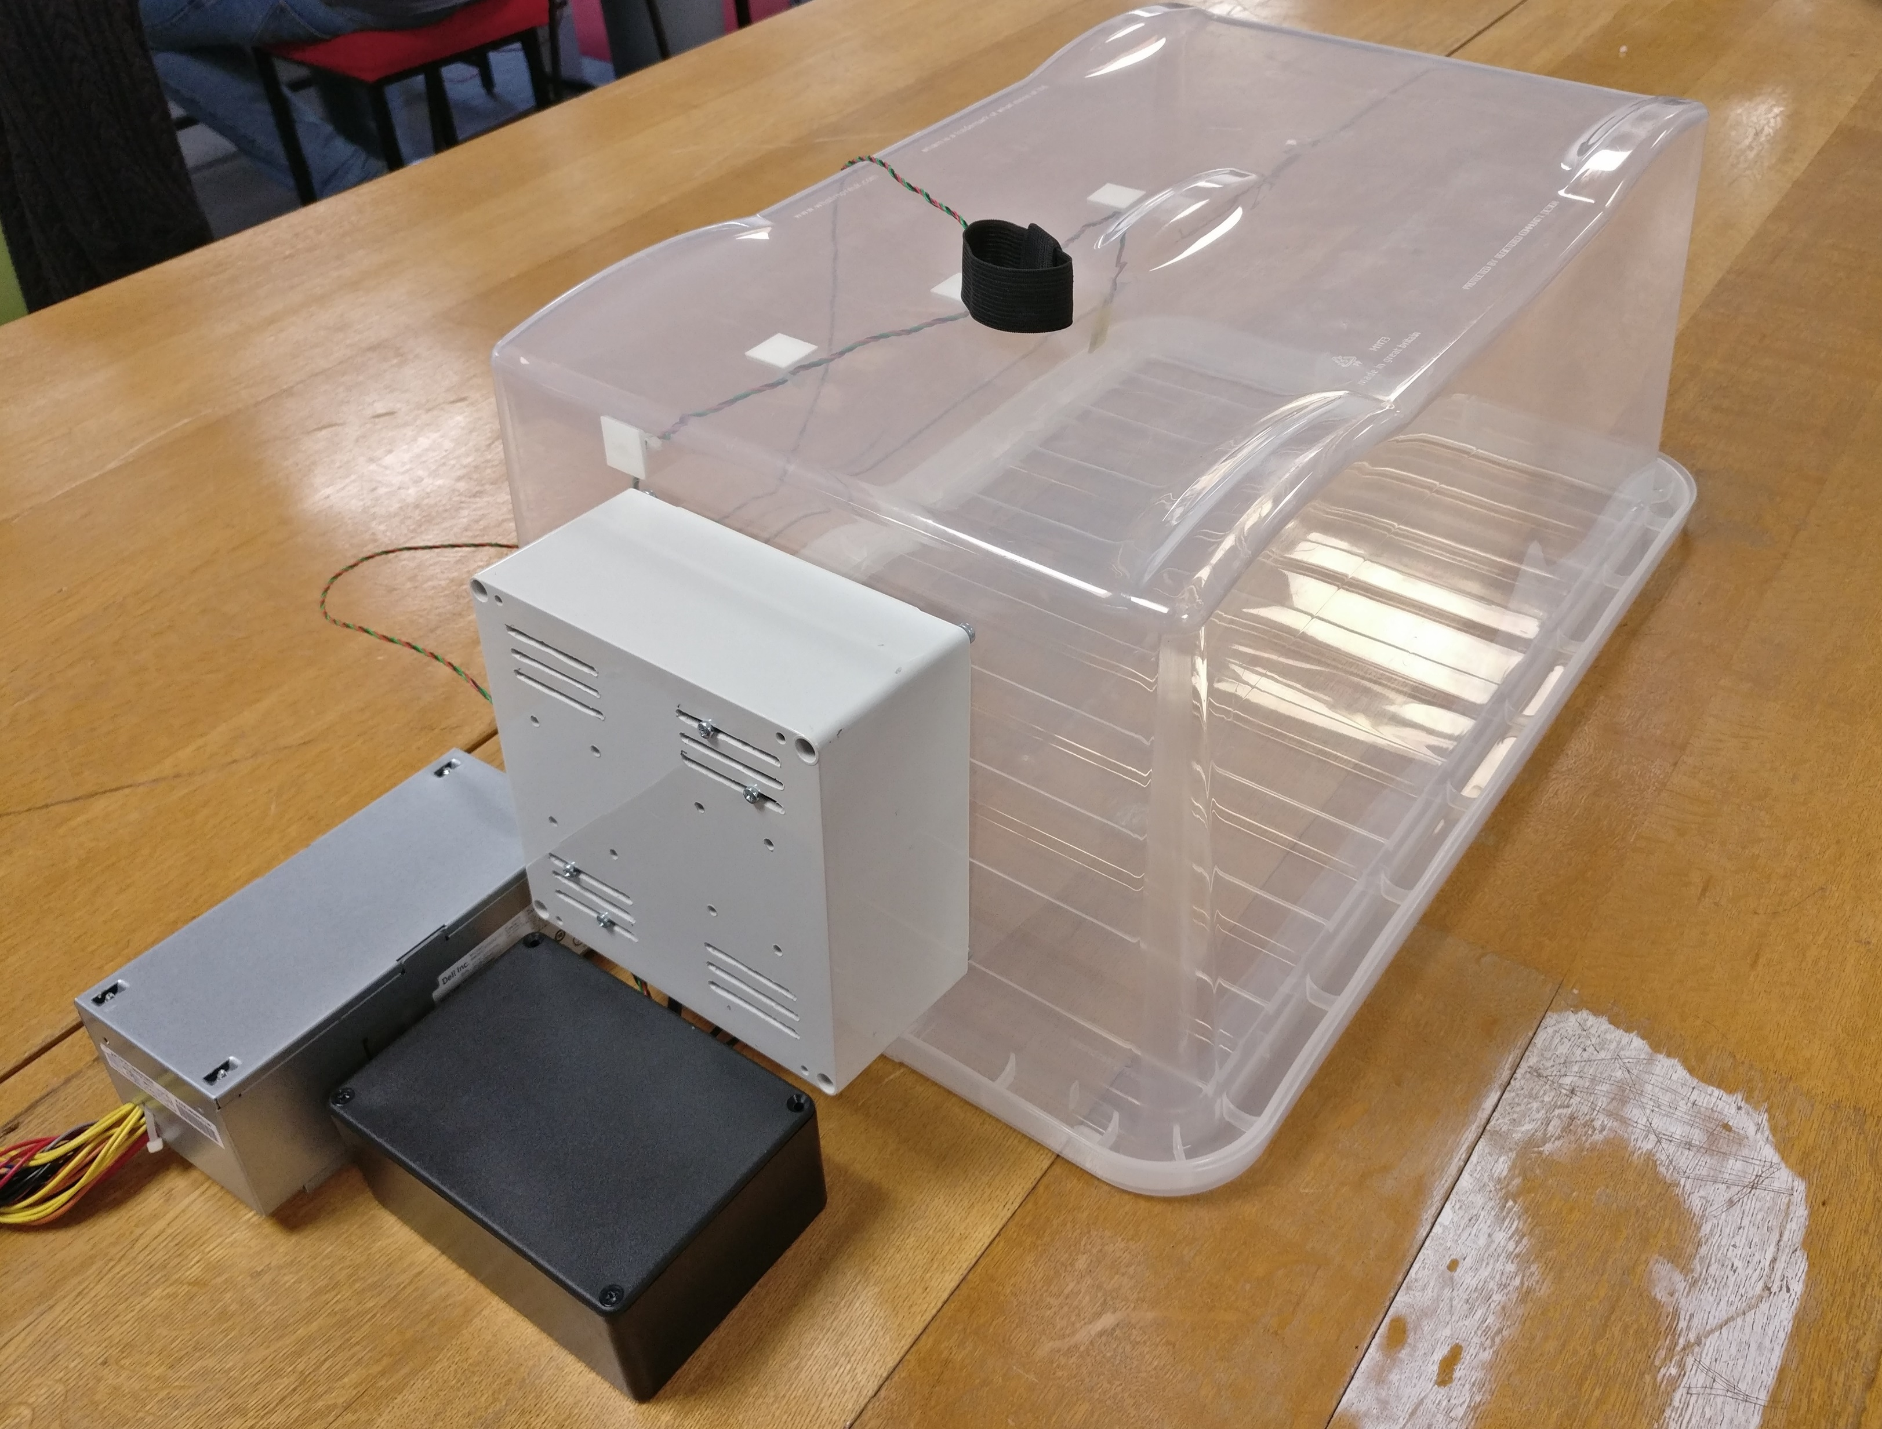
Enclosure Temperature Sensor
Power Unit
Neonate Temperature Sensor
Heating Element and Fan Unit
Primary Electronics

